Slide 1
Speaker Recognition Using K-Nearest Neighbors and MFCC Features
Hamza Zamani, Taishi Kato, David Rosenwasser
M214A – Digital Speech Processing, Winter 2019
3/9/2019

Slide 2
Overview
Goals and Challenges
Block Diagram
MFCCs and Feature Extraction
K-NN and Final Results
Alternate Approach (Neural Networks)

Slide 3
Goals and Challenges
Goal: Develop an accurate speaker verification system to determine if one speaker is the same as another
Use Digital Speech Processing and machine learning techniques
Challenges:
3-5 second samples
Text-independent and text-dependent cases
Open data set

Slide 4
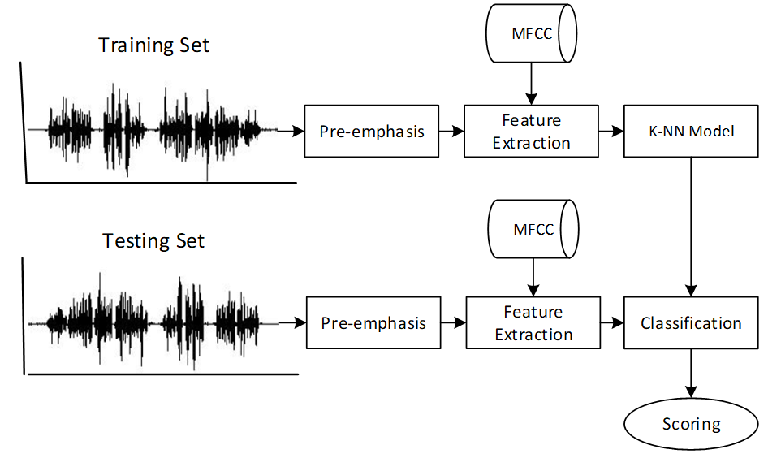
Block Diagram

Slide 5

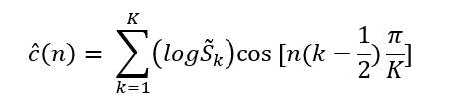

Mel-Frequency Cepstral Coefficients
Widely used feature for speech and speaker recognition
Operates in the mel-domain, a warped frequency representation modeled after the human auditory system
Log of Fourier spectrum
Mel-scale filter bank analysis
Discrete Cosine Transform (DCT)
$\tilde{S}$(k)
f

Slide 6
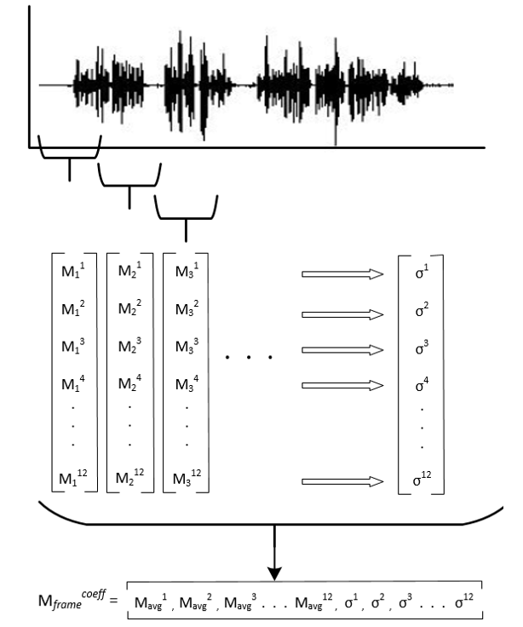
Feature Extraction
12 MFCCs
12 StdDeviations
Experimented with:
F0
Delta MFCC
Delta delta MFCC

Slide 7
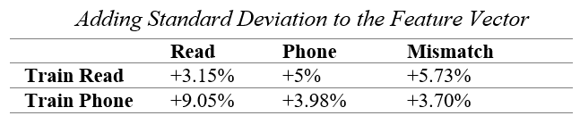
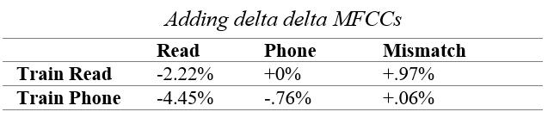
Feature Extraction Data
Removing F0, runtime went from 1516.22s to 30.25s

Slide 8
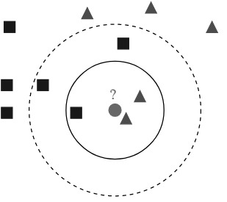
K-Nearest Neighbors
Feature representations are mapped across the KNN feature space
According to the defined parameters, the KNN will determine if the two speakers are the same or not

Slide 9
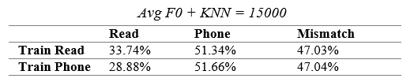
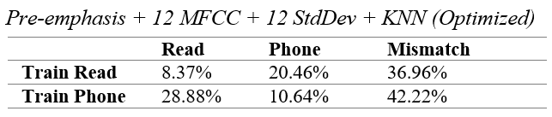
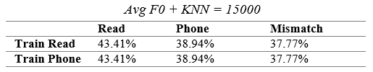

Results
Difficult to provide a robust model for both text-independent and text-dependent cases
Old Data
New Data

Slide 10
Neural Network

Slide 11
Thank You

